Slide 1
CHANGE IN ROLE OF
PUBLIC SECTOR ENTERPRISES
IN INDIA

Slide 2
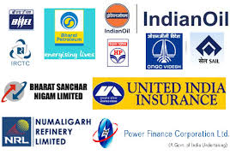
PUBLIC SECTOR ENTERPRISES
Notes:
A state-owned enterprise in India is called a public sector undertaking (PSU) or a public sector enterprise. These companies are owned by the union government of India, or one of the many state or territorial governments, or both. The company stock needs to be majority-owned by the government to be a PSU. PSUs may be classified as Central Public Sector Enterprises (CPSEs), public sector banks (PSBs) or State Level Public Enterprises (SLPEs).
CPSEs are companies in which the direct holding of the Central Government or other CPSEs is 51% or more. They are administered by the Ministry of Heavy Industries and Public Enterprises. For being the navratan company there is 6 caretria
United India insurance company,BHEL Bharat Heavy Electricals Limited
Allhabad bank,uco bank,dena bank.IDBI bank etc

Slide 3
OBJECTIVES
INFRASTRUCTURE DEVELOPMENT
BALANCED REGIONAL DEVELOPMENT
EMPLOYMENT GENERATION
PUBLIC WELFARE

Slide 4
PRE - LIBERALISATION ERA
(1947 - 1991)

Slide 5
ADVENT OF PUBLIC SECTOR ENTERPRISES
POST INDEPENDENCE
INSTRUMENT FOR SELF-RELIANT ECONOMIC GROWTH
Notes:
When India achieved independence in 1947, India was primarily an agricultural country with a weak industrial base. The national consensus was in favour of rapid industrialisation of the economy which was seen as the key to economic development, improving living standards
The private sector in India at that time was
infact incapable of handling big affairs and the long term gestation period investment policies could be implemented only by booking the publicsector
and services, mineral resources and railways, waterways, shipping and
other public utilities.

Slide 6

ROLE PLAYED BY THE
PUBLIC SECTOR ENTERPRISES
Development of Infrastructure and Heavy Industries
Steel Authority of India Limited (SAIL) - 1974
Rourkela Steel Plant (1954)
Bhilai Steel Plant (1955)
Durgapur Steel Plant (1956)

Slide 7
Regional Balance
Strong Industrial Base
Import Substitution & Export Promotion
Concentration Of Economic Power
Self - Reliance

Slide 8
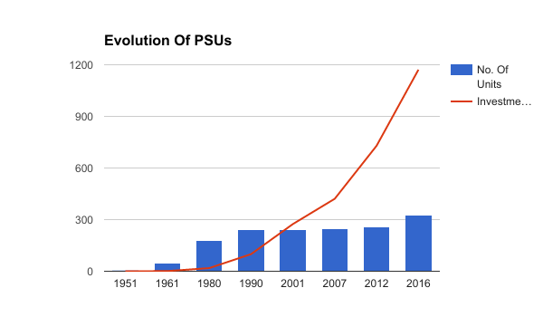
Source:- Public Survey Report (2015-16)

Slide 9
PROBLEM FACED IN THE GOVERNANCE OF PSUs
(ROADMAP TO ECONOMIC REFORMS)

Slide 10

Inappropriate Pricing Policy
Corruption
Technological gap
Political Interference
Notes:
(iv) Technological Gap:
Some of the public sector enterprises in India are suffering from technological gap as these enterprises could not adopt up-to-date technologies in their production system leading to high unit cost and lower yield. Enterprises like I.I.S.C.O., E.C.L. etc. are suffering from this constraint.
(v) Government Interference:
Much government interference in the day to day activities of the public sector enterprises has reduced the degree of autonomy of the managements in respect of employment, pricing, purchase etc.
BOP-
So there was a need to boost the economy

Slide 11


Slide 12
POST - LIBERALISATION ERA
(1991 - PRESENT)

Slide 13
DISINVESTMENT
Notes:
Disinvestment is the action of an organization or government selling or liquidating an asset or subsidiary.

Slide 14
OBJECTIVES
IMPORTANCE
To reduce the financial burden on the govt.
To introduce competition in market.
To fund growth.
Privatization
Financing the increasing fiscal deficit.
For retrieving govt. Debt.
To concentrate more on social programmes.
Financing large scale infrastructure development.

Slide 15

DE - RESERVATIONS

Slide 16
INDUSTRIES RESERVED FOR PSUs
BEFORE
AFTER
A TOTAL OF 17 INDUSTRIES
WERE EXCLUSIVELY UNDER PUBLIC SECTOR.
Eg:-MINING OF IRON ORE,COPPER,ATOMIC ENERGY ETC.
THIS NUMBER WAS REDUCED
TO 8 AFTER 1991.
CURRENTLY THE NUMBER HAS REDUCED TO 2.
Eg:-ATOMIC ENERGY,
RAIL TRANSPORT.

Slide 17
CLASSIFICATION OF PSUs

Slide 18
MAHARATNA
NAVRATNA
MINIRATNA

Slide 19
MEMORANDUM OF UNDERSTANDING
(MOU)
Bilateral or Multilateral agreement between the PSUs and the Administrative Ministries.
Notes:
Why mou??
What is mou??
Benifits??
A memorandum of understanding (MoU) describes a bilateral or multilateral agreement between two or more parties.
Bring all the public sector enterprises under the system of MOU.
It gives clear targets to PSUs and ensures operational autonomy to them for achieving those targets
4 CPSE to 202 CPSEs upto 2010-11
Increases the efficiency

Slide 20
IMPACT

Slide 21

POSITIVE
Improved Efficiency
More Investments
Hike In Salary
Better Utilisation Of Funds
More Transparency

Slide 22
DEMERITS
SUGGESTIONS
Created economic disparities
Although improvement in PSUs Disinvestment continued
Ignored social development and benefits
Underemployment
Govt should have evolved a policy on reforms in public sector rather than only disinvestment
Increase the competition
Increase the standard of public sector enterprises to manage the competition from both domestic and foreign competitors.

Slide 23
CONCLUSION

Slide 24

GOVERNMENT CONTROLLED TO MARKET DRIVEN
EFFICIENCY, TECHNOLOGY ADVANCEMENTS

Slide 25
Thank You

